Slide 1
Building an Institutional Culture of Academic Quality Assurance
Approaches from EHL’s Practices and Educational Philosophy
Nathalie L’HUILLIER, PhD
Certification & Accreditation Manager
Mario SIDES DURA
Certification Project Manager
November 27, 2024

Slide 2
Welcome!
Today’s Objectives
Understand the importance of Academic Quality Assurance
Learn How to Build a Quality Culture
Explore EHL’s Practices & Educational Philosophy

Slide 3

Vision & Mission
Through the EHL Certification Scheme, the EHL Group ambitions to support hospitality education institutions in their continuous journey towards excellence.
The EHL Certification Scheme is a quality assurance framework addressing the needs of hospitality and tourism education institutions to continuously improve their educational offer and internal organization.
2004 - 2019 | Original Scheme
2020 - 2024 | New Certification Scheme
2024 - onwards | Revised Standards 2025

Slide 4
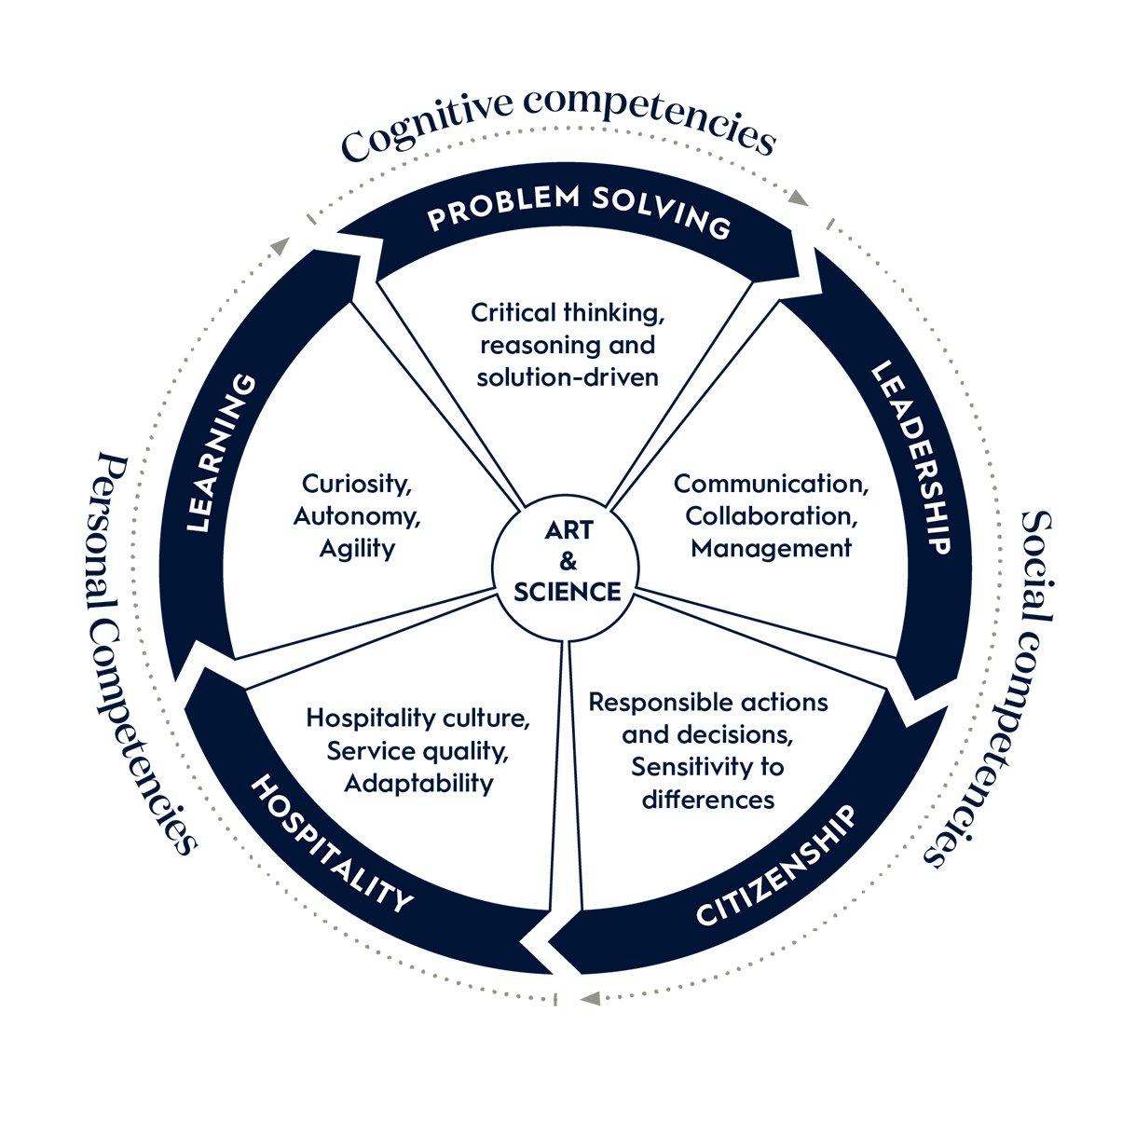
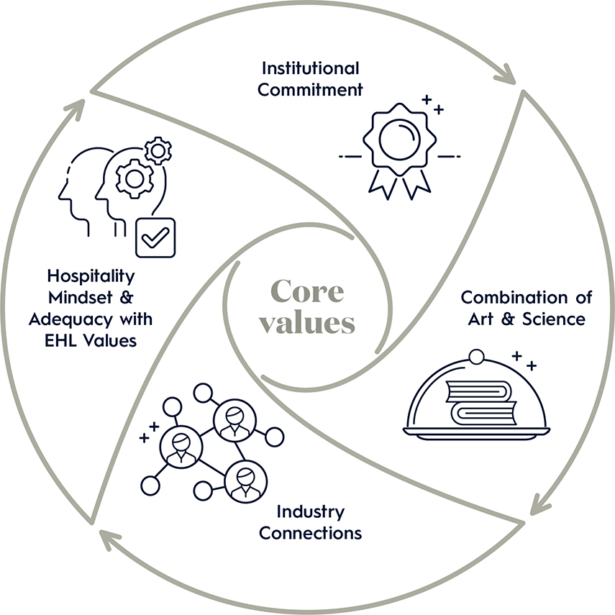
EHL ‘s Educational Philosophy
Notes:
Hospitality Mindset: Embracing a culture of service and international collaboration.
Industry Connections: Building strong partnerships with the hospitality sector.
Combination of Art & Science: Balancing practical skills with academic excellence.
Institutional Commitment: Ensuring continuous improvement and educational quality.
Experiential Education - Learning from experience involves being open to new situations and perspectives, integrating these ideas, and being able to experiment in real-world situations
A Social Learning Context - Learning is a social process and to be successful at EHL and in the business world, students learn to work together throughout their studies.
Leadership - EHL students learn to become leaders, not just managers. Leadership involves influencing others to achieve a common goal.
An Awareness of and Appreciation for Lifelong Learning - An EHL education provides students with an awareness that learning is a lifelong process. EHL graduates obtain the skills and drive necessary to continue to learn long after their academic journey at EHL.

Slide 5

Building a Quality Culture

Slide 6
How do you Build a Quality Culture?
Mission Driven
Empowerment and accountability
Leaders and ambassadors
Communication
Collaborative & inclusive mindset
Notes:
These are the ingredients we consider important
=> Quality is systemic => role of “quality department” is to foster and support quality processes
Start with the mission: identification / clear purpose
Empowerment and accountability: vs culture of control / also encourage people to feel secure talking about areas of improvement
Leaders and ambassadors: strong message from top management / champions
Communication: value good practices & communicate about steps towards improvement (be humble/candid about what needs to be improve)
Collaborative and inclusive mindset: should come as a result / quality is institutional – not a task from a department or person (QM)
Importance of each department/function in the global quality+ collective intelligence for improvement (externality is good)
Discussion point: what does your institution’s quality culture look like?
***
There exists a range of QA instruments which have their respective merits and challenges. This diagram represents a state-of-the-art situation when it comes to the most holistic quality environment and culture. [DISCUSS THE 5 ELEMENTS OF THE DIAGRAM]
One instrument, often found in North-American style accreditations, is continuous improvement (through self evaluation). It is a more of an abstract concept, which can be manifested through a number of operational policies and systems. Audits are more specific. They are systematic investigations of a specific area of operations. Audits are well known in business areas such as accounting, human resources but also in educational quality assurance systems.

Slide 7



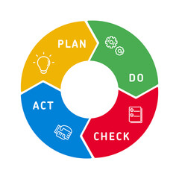
Key Elements of Quality Assurance
Robust Data Collection
Effective Reporting
Continuous Improvement
Why it’s essential:
Supports evidence-based decisions.
Methods:
Surveys, assessments, feedback forms.
Reliable processes: Accurate and timely collection.
Purpose of Reporting:
Support decision-making
Areas of Emphasis
Key Report Features:
Clear Summary
Data Visualization
Impact & Evidence
Audience-Specific reporting:
Management, Faculty, Students.
PDCA model:
Plan-Do-Check-Act.
Strategies:
Data-driven changes, regular updates.
Monitor & evaluate: Impact on quality and outcomes.
Notes:
Hospitality Mindset: Embracing a culture of service and international collaboration.
Industry Connections: Building strong partnerships with the hospitality sector.
Combination of Art & Science: Balancing practical skills with academic excellence.
Institutional Commitment: Ensuring continuous improvement and educational quality.
Experiential Education - Learning from experience involves being open to new situations and perspectives, integrating these ideas, and being able to experiment in real-world situations
A Social Learning Context - Learning is a social process and to be successful at EHL and in the business world, students learn to work together throughout their studies.
Leadership - EHL students learn to become leaders, not just managers. Leadership involves influencing others to achieve a common goal.
An Awareness of and Appreciation for Lifelong Learning - An EHL education provides students with an awareness that learning is a lifelong process. EHL graduates obtain the skills and drive necessary to continue to learn long after their academic journey at EHL.

Slide 8
Case Studies & Examples

Slide 9


What success stories or best practices can you share?
Let us know!

Slide 10
Questions?

Slide 11




Key Takeaways
Importance of Quality Culture
Ensures institutional alignment with excellence.
Drives measurable improvements in education outcomes.
Strategies for Building a Quality Culture
Empowerment, accountability, and leadership.
Effective communication and inclusive collaboration.
Robust Data Collection: Accurate and actionable data is critical.
Effective Reporting: Tailor communication for impact.
Continuous Improvement: The PDCA cycle for ongoing progress.
Key Elements of Quality Assurance
Build on the strategies and insights from today!
And from others!
And from the Network!
Best Practices and Case Studies
Notes:
Hospitality Mindset: Embracing a culture of service and international collaboration.
Industry Connections: Building strong partnerships with the hospitality sector.
Combination of Art & Science: Balancing practical skills with academic excellence.
Institutional Commitment: Ensuring continuous improvement and educational quality.
Experiential Education - Learning from experience involves being open to new situations and perspectives, integrating these ideas, and being able to experiment in real-world situations
A Social Learning Context - Learning is a social process and to be successful at EHL and in the business world, students learn to work together throughout their studies.
Leadership - EHL students learn to become leaders, not just managers. Leadership involves influencing others to achieve a common goal.
An Awareness of and Appreciation for Lifelong Learning - An EHL education provides students with an awareness that learning is a lifelong process. EHL graduates obtain the skills and drive necessary to continue to learn long after their academic journey at EHL.

Slide 12
Thank you!

