Slide 1

Marketing & Branding Webinar
October 2024

Slide 2

EHL Group has undergone significant changes in the past 2 years
The organization has restructured to unify under a single, cohesive structure and a central mother brand.

Slide 3
Implications for Network Schools
EHL is revising its various guidelines and ways of collaborating with all its stakeholders.
Stronger Brand Identity
Enhanced Support and Resources
Greater Global Reach
Streamlined Processes
Notes:
What does this mean for our partners?

Slide 4
A Stronger Brand identity

Slide 5
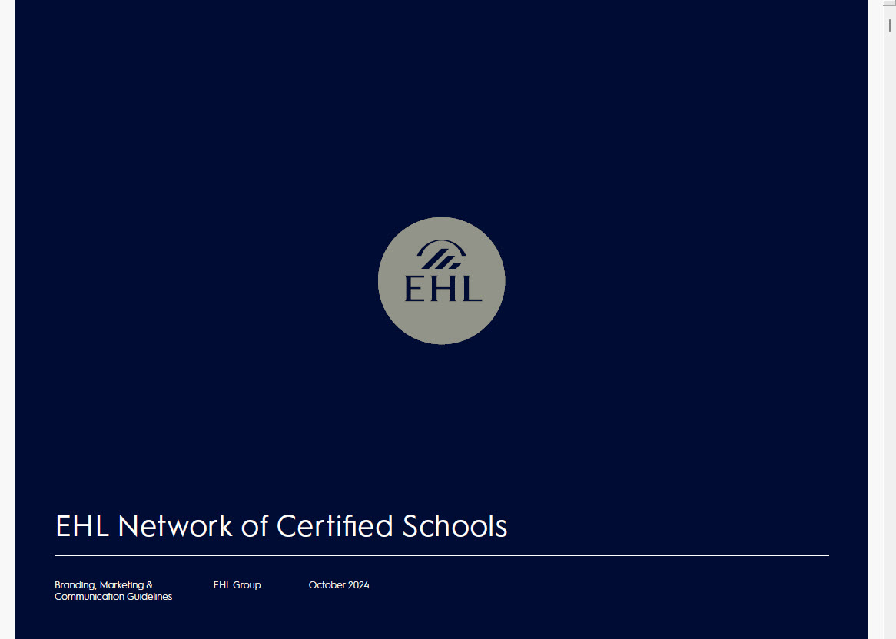
Stronger Brand Identity
A unified brand structure enhances recognition and consistency across all communications and collaborations.
New and more complete Branding,
Marketing & Communication Guidelines
New EHL Network of Certified Schools logos
Ready to use templates
Notes:
What does this mean for our partners?

Slide 6

New Logos
To clearly identify the certification status of our member schools, EHL has revised the logos to be used.
There are 2 versions available:
Horizontal
Stamp

Slide 7

Co-Branding
When you engage in student recruitment activities, you often wish to highlight your relationship with EHL.
We recommend that you prioritize promoting your own brand, using your relationship with EHL as a complementary element to support and enhance your messaging.
If you wish to incorporate the EHL Network of Certified Schools logos - in accordance with your status -, a co-branding format is permitted.

Slide 8

EHL Photos
EHL is reinforcing its copyright policy and therefore restricting usage of EHL photos.
The photos are available on the private platform. All schools must adjust their marketing and communication material accordingly.
New photos will be produced for the exclusive use of Network schools in 2025.

Slide 9


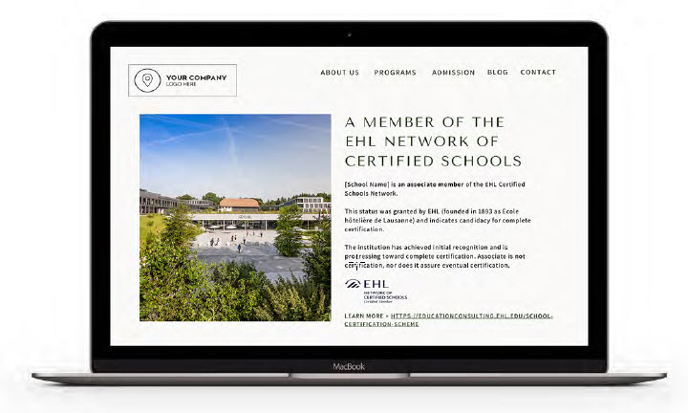
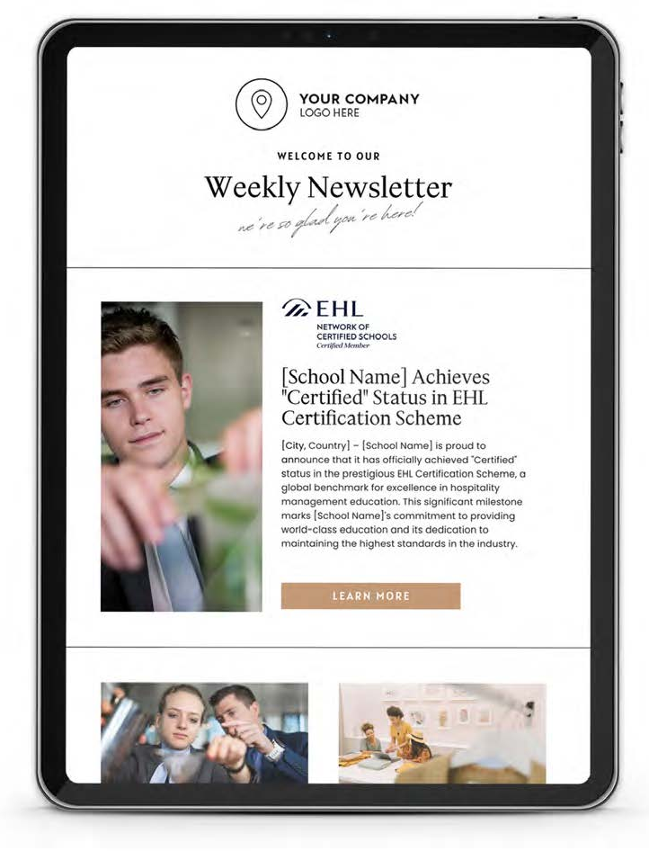
New Wording & Templates
To illustrate best practices, these guidelines include application examples for various branding, marketing, and communication elements.

Slide 10
Reminders
Trademarks:
The EHL name, logo, and seal are trademarks of EHL Group.
Unauthorized use, reproduction, or alteration of these trademarks without prior written consent is prohibited.
Please note that the guidelines may be updated at any time, and it is the responsibility of the network schools to stay informed and ensure that they are always adhering to the latest version of the guidelines.

Slide 11
Enhanced Support and Resources

Slide 12
Enhanced Support and Resources
With a consolidated approach, EHL can provide more robust support, resources, and strategic guidance to its partners.
New online course: Strategic Marketing, Communication, and Recruitment for Educational Institutions
Private Platforms
Newsletters
Notes:
What does this mean for our partners?

Slide 13
New online course
The program is built on 3 elements:
Theoretical Elements: Explore essential concepts, strategies, and frameworks in education marketing, communication, and recruitment.
Supplementary Materials: Engage with curated readings and multimedia resources to broaden understanding and provide deeper context.
Practical Templates: Utilize a variety of templates and tools designed for hands-on exercises and immediate application within your professional role.
We are building them incrementaly for official launch in 2025.
https://educationconsulting.ehl.edu/branding-marketing-communication-trainings
Market Research & Analysis
School Branding & Identity
Marketing & Recruitment Plans
Content Creation & Management
Online Visibility & Presence
Digital Marketing
Communication Strategies
Sales Techniques
Analytics
Social Media Management
Event Management & Promotion
Industry & Alumni Relations
Ethics & Compliance
Professional Development & Networking
Notes:
What does this mean for our partners?

Slide 14
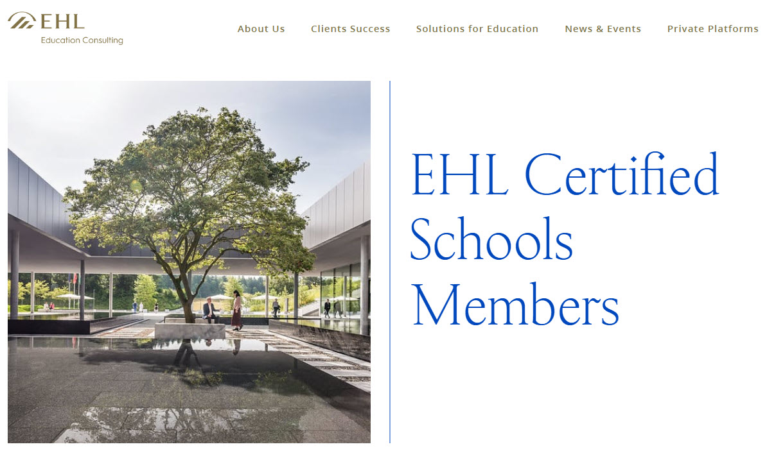
Private Platform
By providing a
centralized platform
for information sharing and collaboration, we aim to enhance the overall experience and support offered to our esteemed members.
Notes:
What does this mean for our partners?

Slide 15
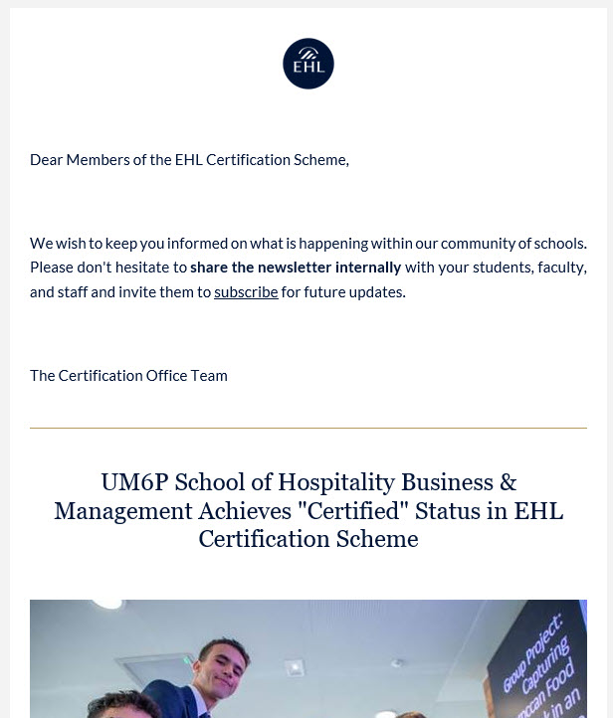
Newsletter
Monthly newletters are sent to all Network schools' members with updates from EHL and their peers.
It is an opportunity to share your best practices, achievements and milestones.
Notes:
What does this mean for our partners?

Slide 16
Greater Global Reach

Slide 17
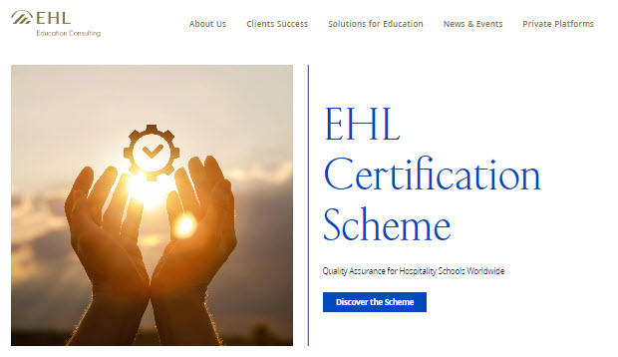
Greater Global Reach
A singular strategy allows for a more substantial global presence, benefiting Network Schools through increased visibility and prestige.
Schools’ page on the
EHL Education Consulting website
New & events section
Blog and case studies
Amplification
Notes:
What does this mean for our partners?

Slide 18

EHL Education Consulting website
Each Network school benefits from
enhanced visibility through a dedicated
page on our platform that links directly
back to their website.
This page provides an overview of
your institution, showcasing key
elements such as your programs
and achievements. The objective is
to drive traffic to your website
and increase your exposure
through EHL's extensive channels.
https://educationconsulting.ehl.edu/certified-schools-network
Notes:
What does this mean for our partners?

Slide 19
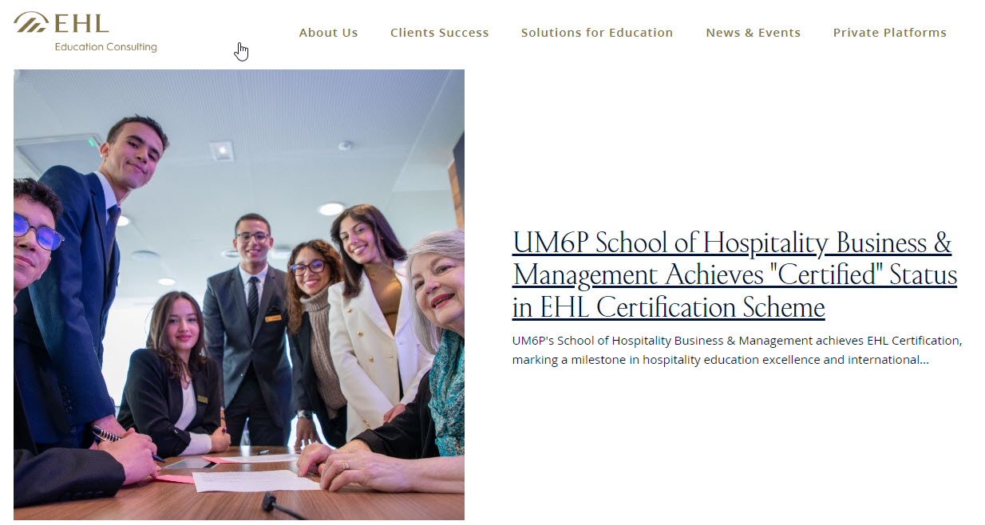
New & events section
There are "News & Events" section across various EHL websites where you can highlight your key milestones. These updates are further promoted through our newsletters, ensuring greater visibility for your achievements.
This provides an opportunity to
gain visibility not only within
the network of certified schools
but also across the broader EHL
network, ensuring your milestones
reach a wider audience.
https://educationconsulting.ehl.edu/news-events/tag/ehl-education-consulting
Notes:
What does this mean for our partners?

Slide 20
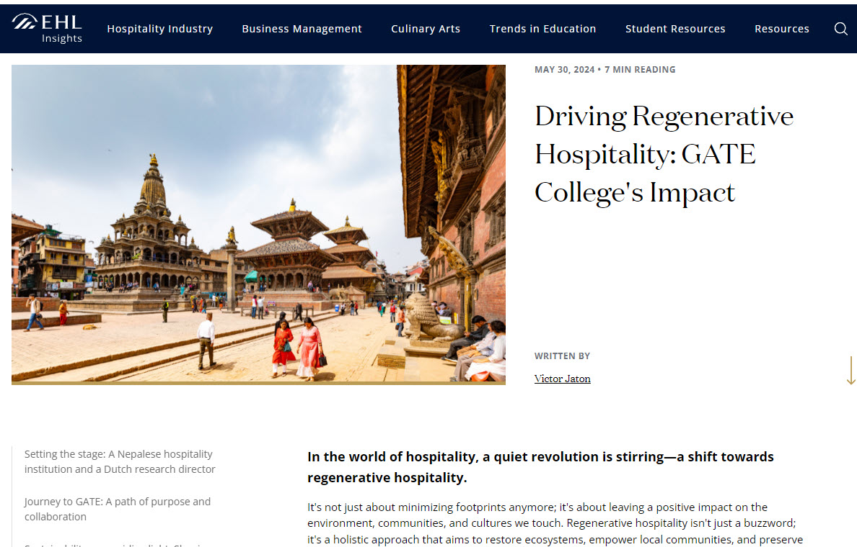
Blog and case studies
A collaboration to highlight your expertise
Together, we can create a tailored content package that effectively highlights your expertise.
We typically suggest combining
a blog post with a case study
(and, if feasible, a video) to be
shared across EHL's platforms,
including the blog and
social media channels.
https://industry.ehl.edu/hubfs/Advisory/Documents/EHL-Advisory-Case-Study-UM6P.pdf
https://hospitalityinsights.ehl.edu/gate-colleges-impact-on-businesses-communities-and-places
Notes:
What does this mean for our partners?

Slide 21
Streamlined Processes

Slide 22
Streamlined Processes
Partners will experience more straightforward processes with a centralized point of contact:
The certification office: Certification.Office@ehl.ch.
All marketing materials, communications, or media that mention EHL and its affiliates must be approved by EHL prior to use.
In case of termination of certification or collaboration, all references to EHL must be removed from all marketing and communication materials immediately.
Notes:
What does this mean for our partners?

Slide 23
Breach of Guidelines and Trust
Importance of Adherence:
Adhering strictly to the branding and communication guidelines is essential to maintain integrity and uphold the reputation of both EHL and network schools.
Consequences of Non-Compliance:
Breaches of confidence, such as unauthorized use of logos or failure to adhere to guidelines, can undermine your relationship with EHL and may result in corrective actions.

Slide 24
THANK YOU

